Slide 1
Coordinator Course
Evaluations, Evaluation Summary and Outcome Summary

Slide 2
This session will cover:
Why do we evaluate our activities?
Evaluation versus Learning Assessment
Learning & Feedback Form
Assessing the Learners
What is an Evaluation Summary?
What is an Outcome Summary?

Slide 3
Why do we evaluate our activities?
To improve program design and implementation
To demonstrate program impact
Required for all CME accredited programs

Slide 4
Evaluation versus Learning Assessment
Evaluation is a process that critically examines a program or activity.
A learning assessment is a method to measure how much of the knowledge and skills a learner has acquired during a course of study.

Slide 5
Learning & Feedback Forms
Our Learning & Feedback Form evaluates the program and assess the learning of the attendee.
We have three different templates, so each program is asked to select the template they will use for their activity.
Click to see Sample Form in Coordinator Templates

Slide 6
Assessing the Learners - Template 1
Direct Test
After the session, attendees complete a test to determine their knowledge. It is graded and shared with the attendee, so they learn the correct responses.
This is the most rigorous form of assessment and is preferred when feasible.

Slide 7
Assessing the Learners - Template 2
Retrospective Pretest/Posttest Survey of Objectives
After the session, the attendee’s rate themselves on their knowledge of the objectives before attending the activity, and their knowledge of the objectives after attending the activity.

Slide 8
Assessing the Learners - Template 3
Commitment-to-Change Response
This assessment method asks an attendee to tell us what is their particular course of action. What piece from this activity are they going to try and implement into their practice?
For Grand Round activities, this is the least effective method and may not provide you with the data you will need to improve your program, nor demonstrate the impact your activity has had on the learner. It is an acceptable method for Journal Clubs or M&M’s.

Slide 9
What is an Evaluation Summary?
An Evaluation Summary is an overall summary of the responses from your Learning & Feedback Forms. The responses are averaged for the entire time period, and it would also include all of the attendee comments for this time period, as well.
Every activity is required to upload into Smartsheet an Evaluation Summary twice a year for the periods of January – June and July – December.

Slide 10
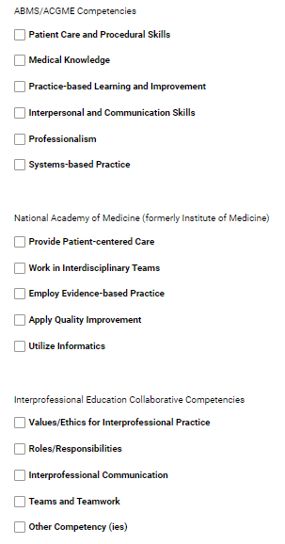
What is an Outcome Summary?
Documentation and evidence to support how your program met these goals.
Gaps
Objectives
Competencies you selected on EPF
It is due the last business day in February for the previous calendar year.

Slide 11
The End
There was a lot of information covered in this set of slides. If you have questions about any of what was covered, please feel free to contact our office.
We are here to help and guide you through the process.

